Slide 1
Introduction to test automation
Foundations of software testing
Jacek Okrojek
16.12.2016

Slide 2
AGENDA
General information
Testing Web applications
Selenium IDE

Slide 3
Objective of test automation
General information
Automate frequently executed tests
Smoke tests – smoke test should be executed after each build to ensure that application is stable enough for testing
Regression test – ensuring that old functions were not negatively affected by new features
Increase test coverage
Execution of tests that are difficult or impossible to perform manually (typically this applies to performance, security)
Execution much bigger number for test cases

Slide 4
Testing pyramid
General information
Testing pyramid represents proportion between various levels of test
Applies to automated and manual tests
Guideline for efficient testing
Reduce time spend on creation and maintenance
System tests
Performed on fully integrated system
Integration tests
Well... everything between
system and unit tests
Performed on a
single unit
Unit tests

Slide 5
Interacting with web application
Testing Web application
In order to interact with web application (get or set texts and perform other actions) we need to have technology that allows for selecting element for interaction, typically we can use:
HTML tag elements like id, name or link text
CSS selectors
XPATH selectors
Image recognition
<html>
<div class="rf-logo" >Rule Financial - The Sector Specialists</div>
<div class="GOFRIDJCHI">
<div class="control-group">
<label>Your first name</label>
<input class="gwt-TextBox" type="text" name="firstName">
<div class="gwt-Label" style="display: none;" aria-hidden="true">Please provide your first name using only alphabetic letters. The length required is between 1 and 20 characters.</div>
</div>
</div>
<div class="GOFRIDJCHI">
<div class="control-group">
<label>Your last name</label>
<input class="gwt-TextBox" type="text" name="lastName">
<div class="gwt-Label" style="display: none;" aria-hidden="true">Please provide your last name using only alphabetic letters. The length required is between 1 and 40 characters.</div>
</div>
</div>
</html>

Slide 6
CSS selectors
Testing Web application
Notation that allows for selecting HTML elements base on the tag names and attributes:
.rf-logo
div.rf-logo
div.control-group input[name="firstName"]
<html>
<div class="rf-logo" >GFT - The Sector Specialists</div>
<div class="GOFRIDJCHI">
<div class="control-group">
<label>Your first name</label>
<input class="gwt-TextBox" type="text" name="firstName">
<div class="gwt-Label" style="display: none;" aria-hidden="true">Please provide your first name using only alphabetic letters. The length required is between 1 and 20 characters.</div>
</div>
</div>
<div class="GOFRIDJCHI">
<div class="control-group">
<label>Your last name</label>
<input class="gwt-TextBox" type="text" name="lastName">
<div class="gwt-Label" style="display: none;" aria-hidden="true">Please provide your last name using only alphabetic letters. The length required is between 1 and 40 characters.</div>
</div>
</div>
</html>

Slide 7
XPath selectors
Testing Web application
Notation that allows for selecting XML elements base on the tag names and attributes:
/html/div[1]
/html/div[2]/div/label
/html/div[2]/div/input[@name="firstName"]
//input[@name="firstName"]
//lable[text()="Your first name"]
(//button)[3]
XPath allows us to select elements based on its index in the DOM tree
<html>
<div class="rf-logo" >Rule Financial - The Sector Specialists</div>
<div class="GOFRIDJCHI">
<div class="control-group">
<label>Your first name</label>
<input class="gwt-TextBox" type="text" name="firstName">
<div class="gwt-Label" style="display: none;" aria-hidden="true">Please provide your first name using only alphabetic letters. The length required is between 1 and 20 characters.</div>
</div>
</div>
<div class="GOFRIDJCHI">
<div class="control-group">
<label>Your last name</label>
<input class="gwt-TextBox" type="text" name="lastName">
<div class="gwt-Label" style="display: none;" aria-hidden="true">Please provide your last name using only alphabetic letters. The length required is between 1 and 40 characters.</div>
</div>
</div>
</html>

Slide 8
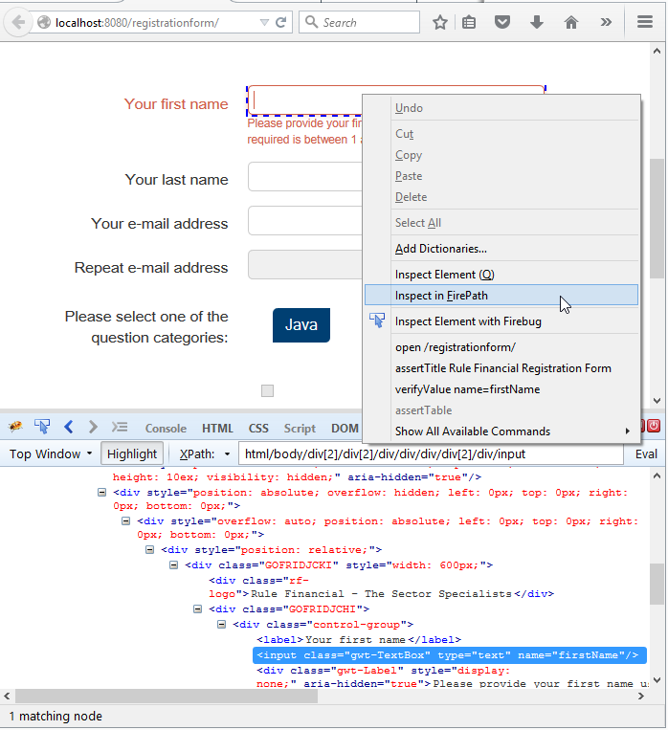
Exercise
Testing Web application
Install following tools
Firefox
Firebug add-on
Firepath add-on
Open http://jacekokrojek.github.io/jak-to-zrobic-w-js/index.html page
Find simplest CSS and XPath selectors for
Example headline 1 text
Feature A text
Sign up today link

Slide 9
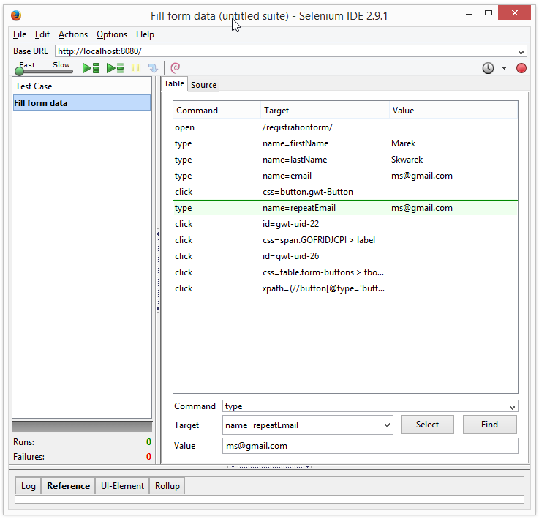
Introduction
Selenium IDE
Simple but powerful tool that allows for recording, modifying and replaying actions performed on the web application
Uses simple command structure
Works on Firefox
Allows for using JavaScript code
Allows for exporting tests to Java, .NET, Python and more languages
Allows for extensions (there are actually many great extensions available now)
References http://www.seleniumhq.org/docs/02_selenium_ide.jsp

Slide 10
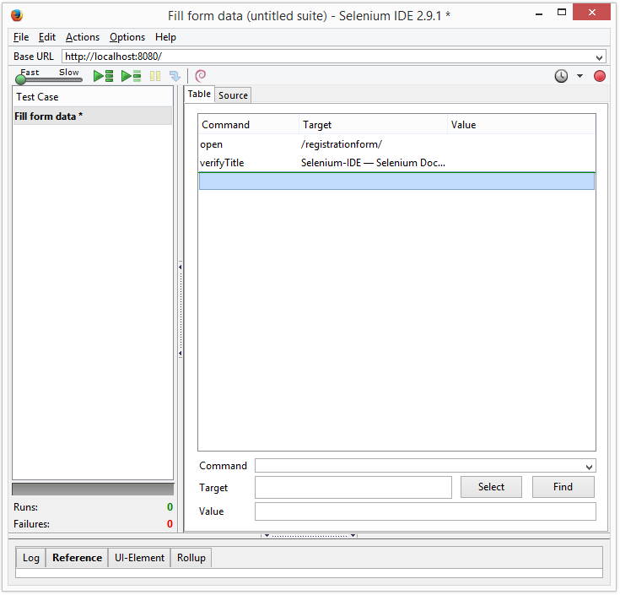
Opening and verifying page status before the test
Selenium IDE
Before the test is started we need to request the tested page
open command opens url that is specified in the target section
Even Selenium IDE will warn us in case of response with 4xx or 5xx codes, it is a good practice to check if requested page was actually opened
verifyTitle command can be used if page title is the same as value specified in the target field

Slide 11
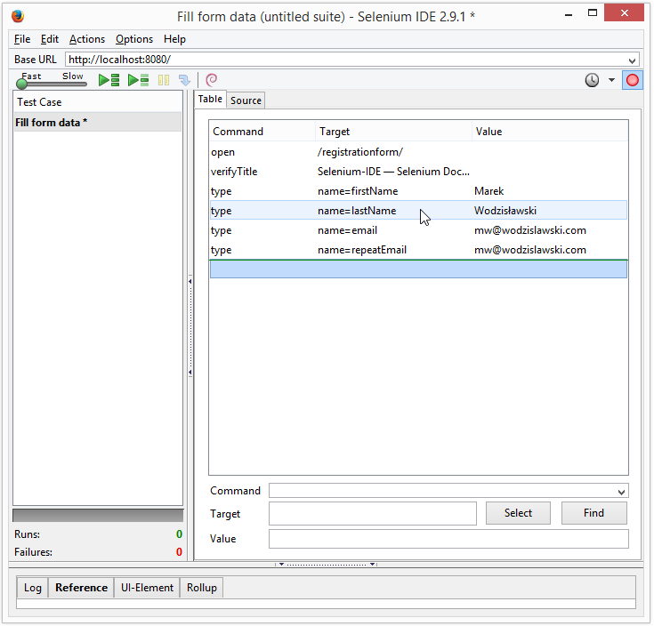
Typing text
Selenium IDE
One of the typical interaction is inserting texts into form fields
type command insert value text into input field specified in the target property
Input fields can be selected based on
id
name
css path
xpath path
Exaple target properties
name=firstName
css=input[name="firstName"]
xpath=//input[name="firstName"]

Slide 12
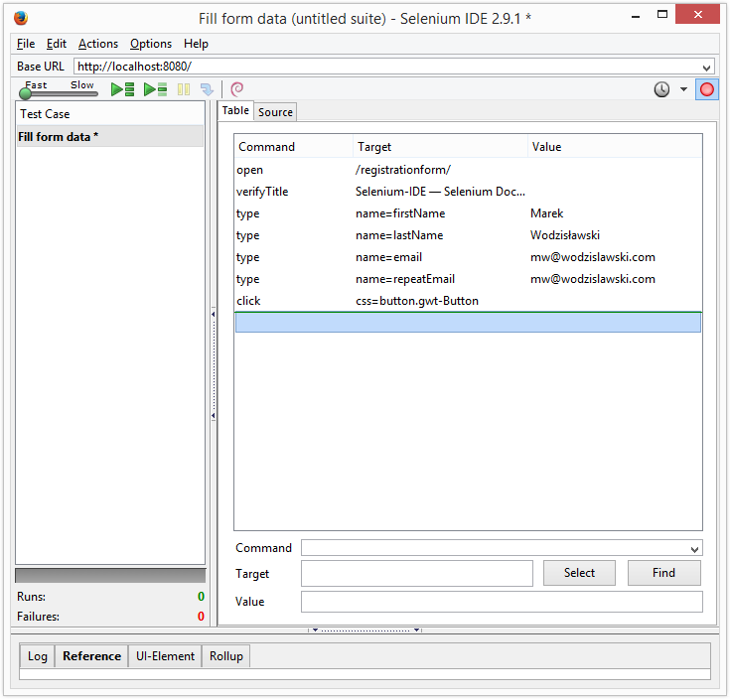
Clicking on elements
Selenium IDE
Selenium allows for clicking on check, radio and regular buttons as well as links
click command simulates left click on the element specified in the target property
Elements can be selected based on
id
name
css
xpath
linkText

Slide 13
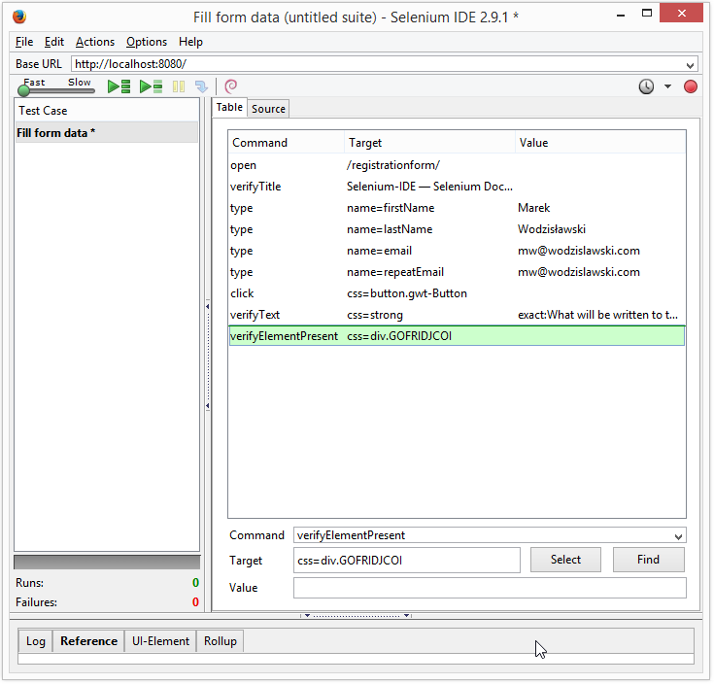
Verifying texts and presence of elements
Selenium IDE
At some point in test it is required to check if performed actions like submitting the form results in correct change of application
verifyText command checks if text of the value property is visible in the element specified by selector in target property
verifyElementPresent command checks element specified by selector in target property exists in the DOM tree
Elements can be selected based on
id
name
css
xpath
linkText

Slide 14
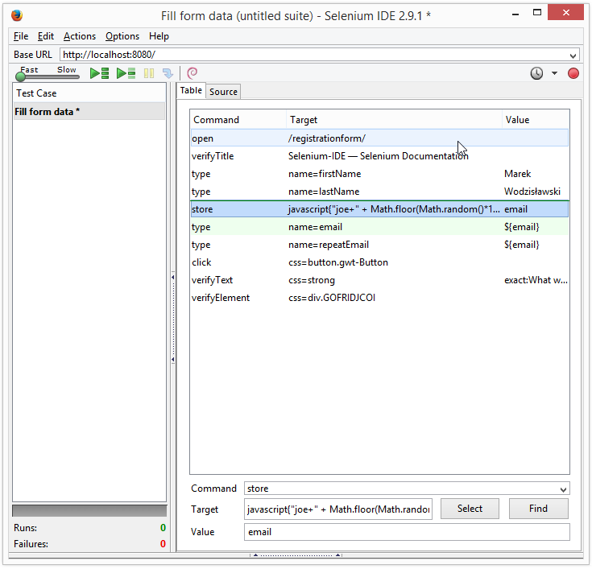
Using variables and JavaScript
Selenium IDE
JavaScript can be used at various places to perform more actions that are not available via standard Selenium IDE command
One of the option is storing values generated by JavaScript code
store command can be used to store value in the variable under name specified in the value property
Stored variable can be later used by ${varName} statement

Slide 15
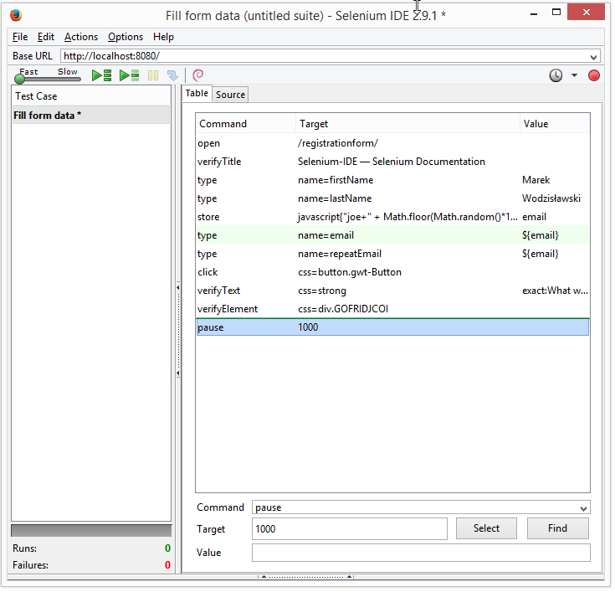
Waiting
Selenium IDE
Sometimes performing action requires some time and test needs to wait until application finish the task
pause command can be used to wait specified amount of time
varius waitForXXX commands can be used in order to wait for an event

Slide 16
Exercise
Selenium IDE
Install Selenium IDE add on (https://addons.mozilla.org/en-US/firefox/addon/selenium-ide/)
Create one test suite
Record tests that will check if application behavior is correct when user provides correct and incorrect credentials on https://the-internet.herokuapp.com/login page
Store tests in the repository

Slide 17
GFT
Jacek Okrojek
Email: Jacek.okrojek@gft.com

